Slide 1
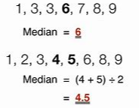
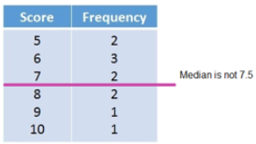

Subtopic N1.5 Finding the median of a set of numbers
LEARNING OUTCOME: To be able to calculate the median
Objectives:
Keywords:
Median
Middle
Midpoint
Order
To be able to find the median of a data set with an odd number of data points.
To be able to find the midpoint of two numbers, using a calculator.
To be able to find the median of a data set with an even number of data points.
Introduction – Read and annotate:
The median is the middle value in a set of numbers when they are put in order from smallest to
largest. This uses the skills you have already learnt in this booklet, such as comparing and ordering
integers. A good understanding of place value helps us spot mistakes and make sure the list is correct
before identifying the centre. The median gives us a sense of the “middle” or typical value in a set of
numbers, helping us understand the overall trend without being affected by very high or low outliers.
Definition
May be an integer or non-integer
Unaffected by outliers
If the median is between two numbers, add those two numbers together and divide by two
The value at the centre of a numerically ordered list of values.
Characteristics
Examples
Median
Non - Examples
Finding the median of a set of numbers, where there is an odd number of values
Steps | Order the numbers from smallest to largest (ascending). Identify the middle number.
Example 1 - I do… Find the median of: | 7, 12, 11, 6, 2
Example 2 – We do… Find the median of: | 301, 44, 96, 88, 201
Example 3 – You do… Find the median of: | 12, 18, 14, 1, 3
7
96
12

Slide 2
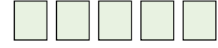
Independent Practice
Question 1. Find the median of the following sets of numbers:
a) 1, 2, 3, 4, 5 | b) 11, 12, 13, 14, 15
c) 32, 33, 34 | d) 10, 12, 7
e) 28, 31, 9 | f) 1003, 1001, 1002
g) 22, 18, 15, 7, 9 | h) 19cm, 20cm, 1cm, 5cm, 7cm
i) 104, 56, 22, 18, 7 | j) 4000, 8000, 1500, 2752, 11000
k) 17km, 18km, 10km, 12km, 3km, 8km, 9km | l) 12ml, 17ml, 3ml, 1ml, 29ml
m) 7, 7, 7 | n) 4, 4, 7, 7, 7
o) 7, 4, 7, 7, 8 | p) 7, 4, 7, 8, 7, 7, 8
3
13
33
10
28
1002
15
7cm
22
4000
10km
12ml
7
7
7
7
Question 2. Five numbers have a median of 8. Fill in the cards to show what the numbers could be.
v
e.g. 2, 5, 8, 10, 13

Slide 3
Find the midpoint of a pair of numbers
 | Example 4 - I do… | Example 5 – We do… | Example 6 – You do…
Steps | Find the midpoint of: | Find the midpoint of: | Find the midpoint of:
1) Add the two numbers together. | 10 and 40 | 11 and 40 | 12 and 40
2) Divide by two to find the midpoint.
25
25.5
26
Independent Practice
a) 5 and 9 | b) 10 and 20 | c) 2 and 8
d) 40 and 60 | e) 6 and 16 | f) 7 and 13
g) 90 and 98 | h) 25 and 31 | i) 4 and 7
j) 3 and 8 | k) 10 and 17 | l) 2 and 21
m) £2 and £5 | n) £1 and £28 | o) 12cm and 55cm
7
15
5
50
11
10
94
28
5.5
5.5
13.5
11.5
£3.50
£14.50
33.5cm

Slide 4
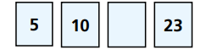
Finding the median of a set of numbers, where there is an even number of values
Steps | Order the numbers from smallest to largest (ascending). Identify the middle number by finding the midpoint.
Example 1 - I do… Find the median of: | 7, 12, 11, 6
Example 2 – We do… Find the median of: | 301, 44, 96, 88
Example 3 – You do… Find the median of: | 12, 18, 14, 1
9
92
13
Independent Practice
Question ??. Find the median of the following sets of numbers:
a) 12, 8, 10, 17 | b) 3, 21, 7, 3
c) 3, 3, 210, 7 | d) 4, 3, 210, 7
e) 3, 5, 6, 10, 15, 20 | f) 3, 5, 6, 6, 15, 20
g) 24, 19, 31, 68 | h) 23, 43, 73, 93
11
5
5
5
6
6
27.5
58
Question ??. The median of these numbers is 12. Work out the missing number.
v
14

Slide 5

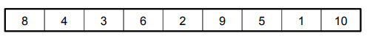

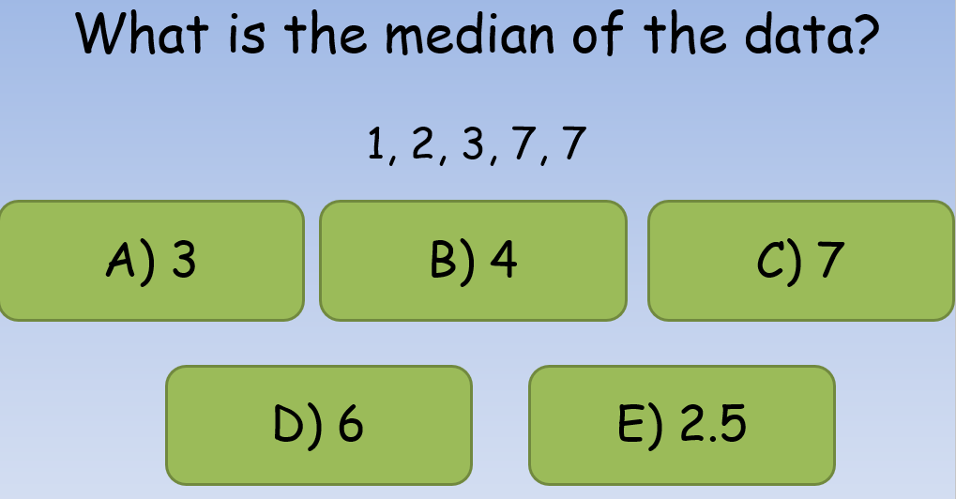
Question ??. Complete the cards so that the median is 7:
9
Question ??.
Christopher has a twin brother aged 12 and two older brothers aged 18 and 14. Work out the median age of the four brothers.
12, 12, 14, 18 Median = 13
Question ??.
Tamaya finds the median of this set of data:
She says the median is 2 because it is in the middle. Explain her mistake.
Tamaya hasn’t ordered the numbers in ascending order before finding the middle value.
Skills Check
Using the number line, what is the midpoint of 11 and 15?
What is the midpoint of 13km and 22 km?
11 c) 13
12 d) 13.5
20 c) 17
16 d) 17.5
The midpoint of two numbers is 10.
The smallest number is 4, what is the largest?
12 c) 16.5
16 d) 18.5

